Slide 1

Web Site Redesign
Website for Yoga Studio
Image source: https://md3.pt/wp-content/uploads/2019/04/Why-Web-Design-Is-A-Good-Career-Choice.jpg

Slide 2
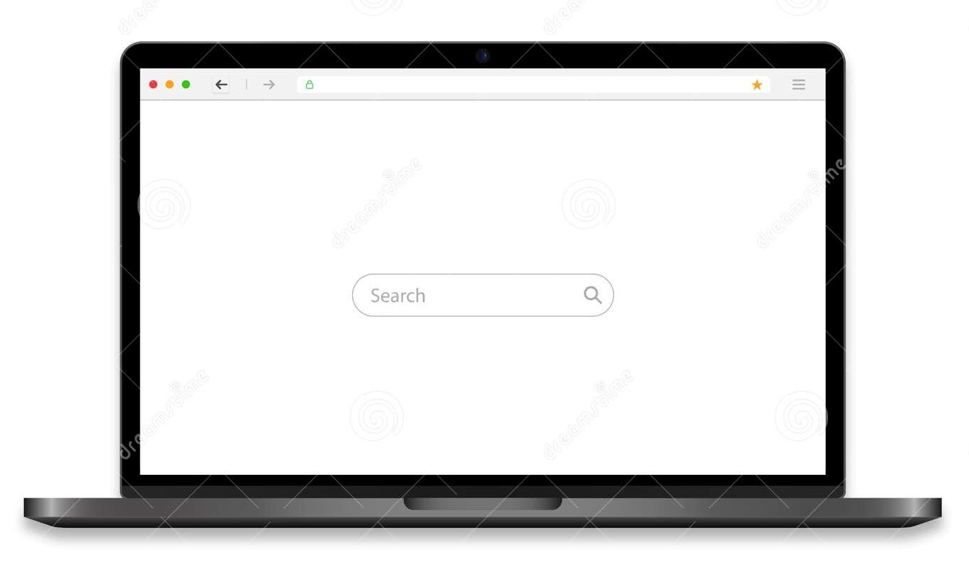
Desktop View

Slide 3
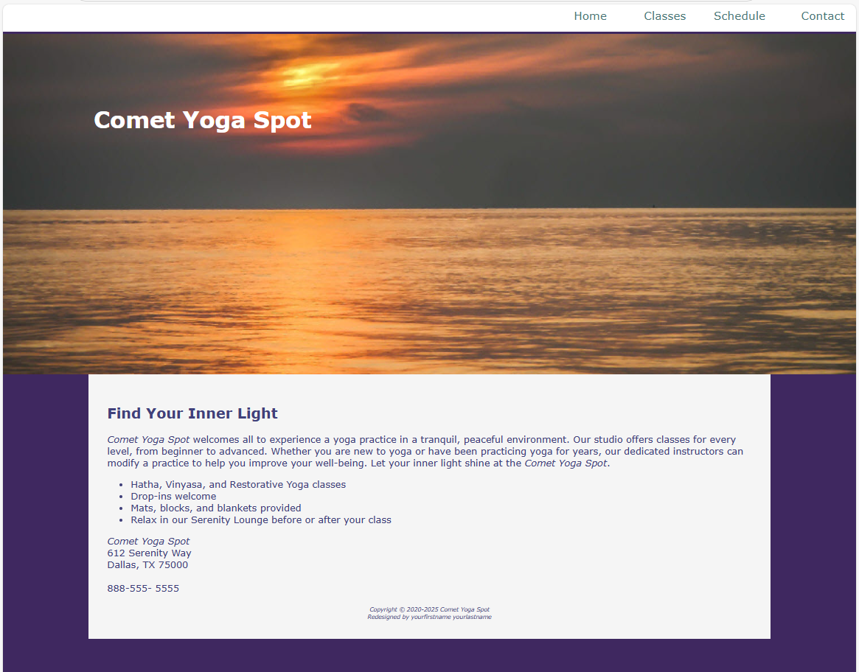
Index.html

Slide 4
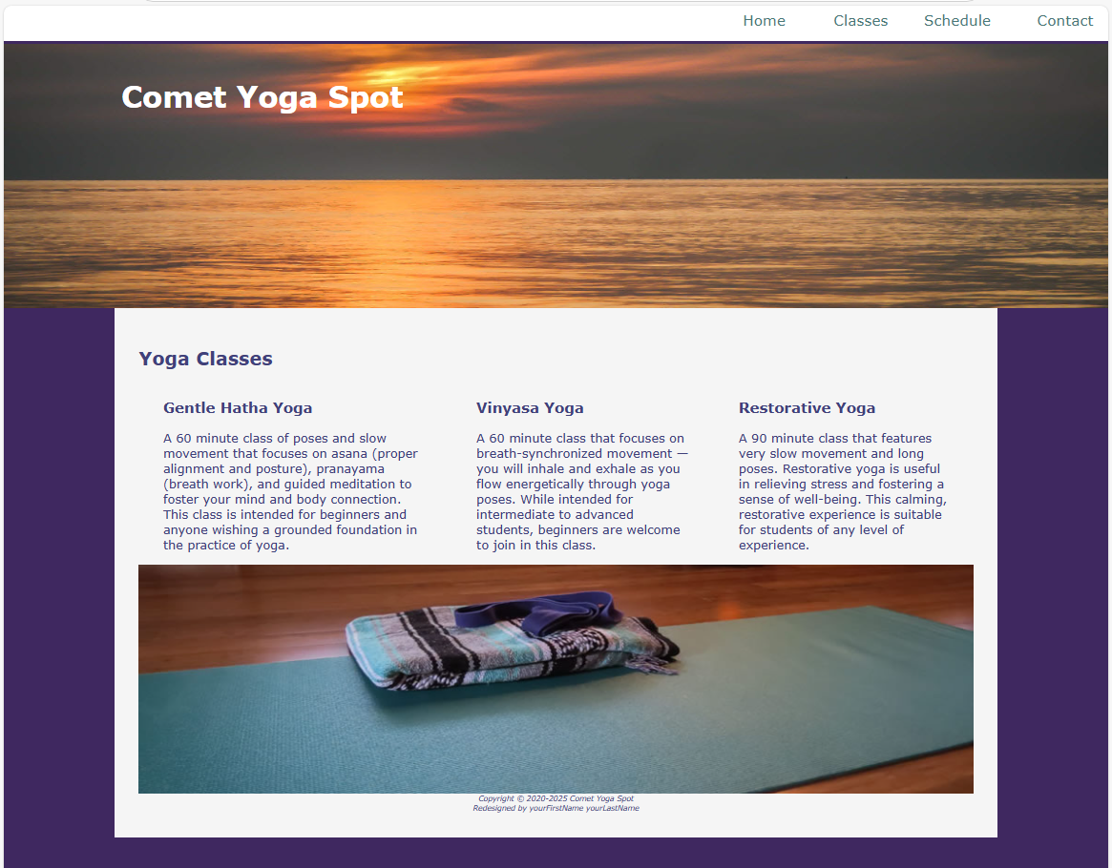
classes.html

Slide 5
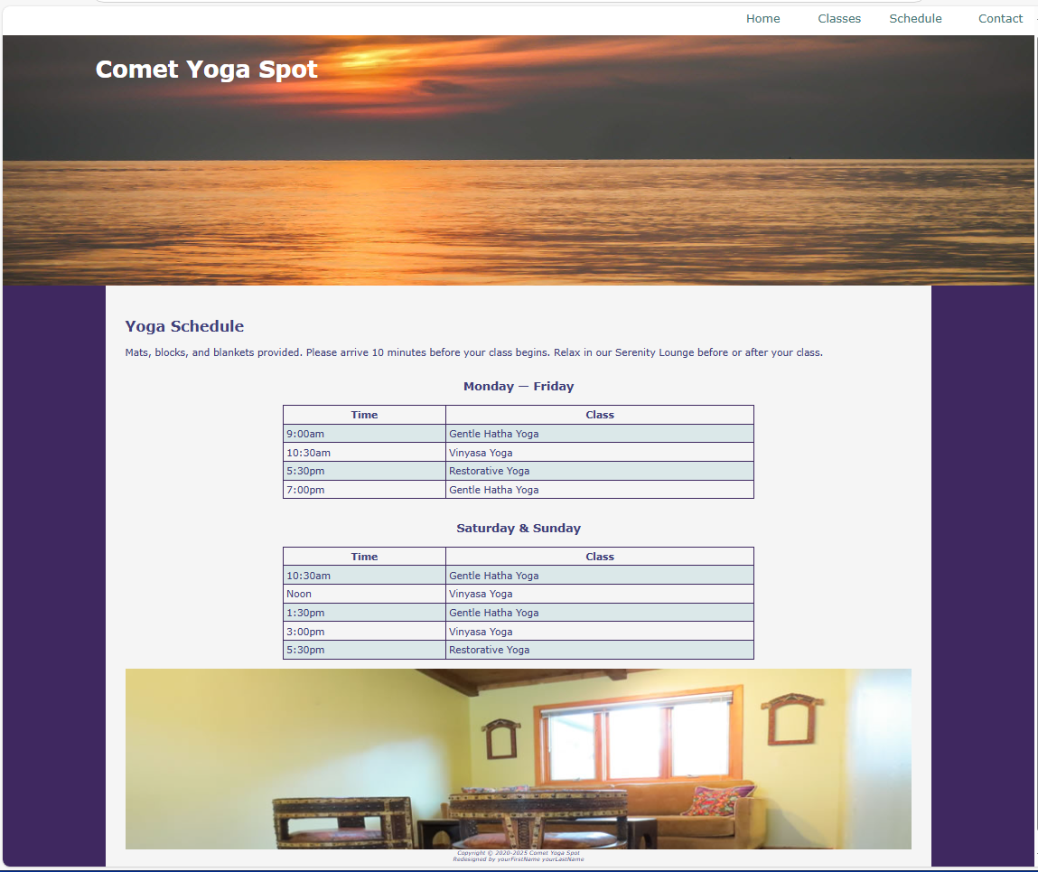
schedule.html

Slide 6
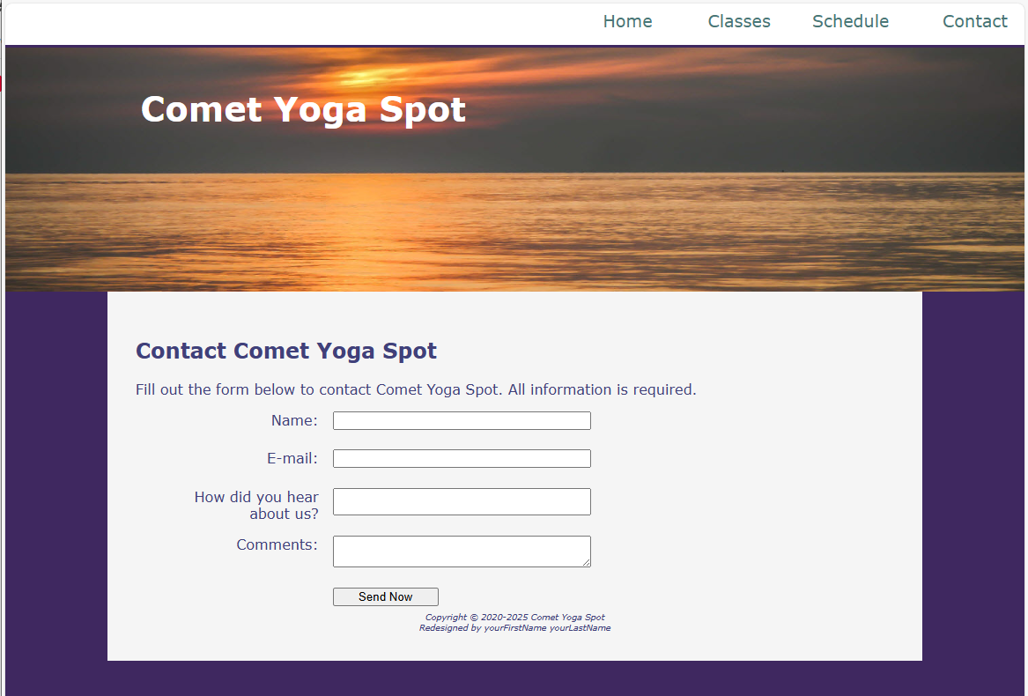
contact.html

Slide 7

Mobile View

Slide 8
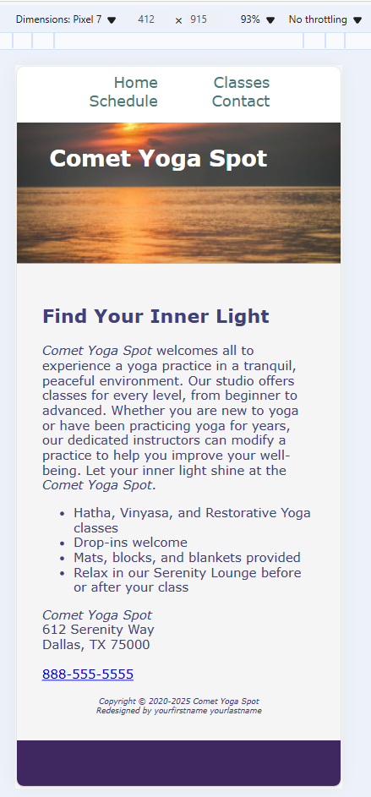
index.html

Slide 9
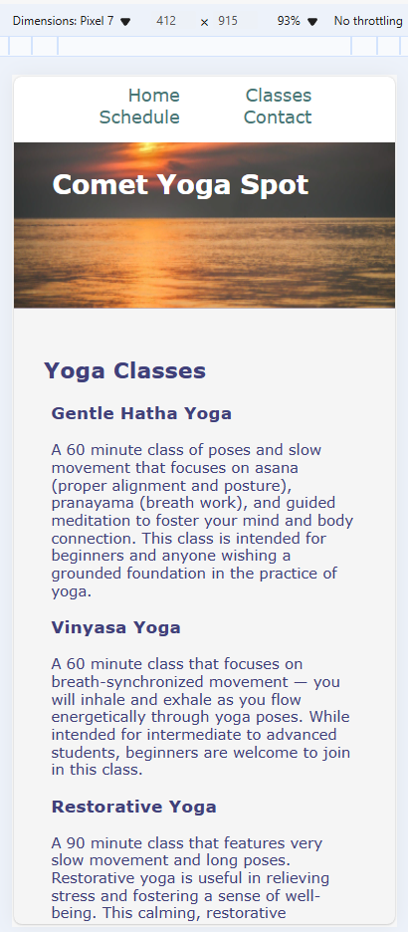
classes.html

Slide 10
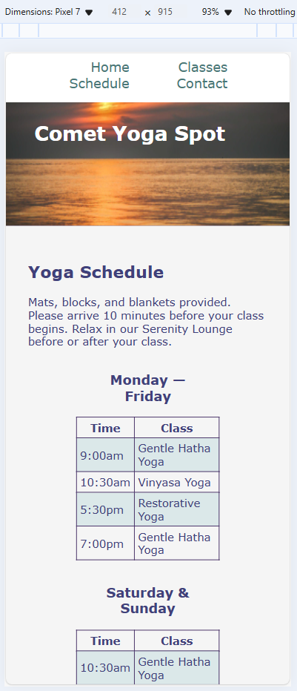
schedule.html

Slide 11
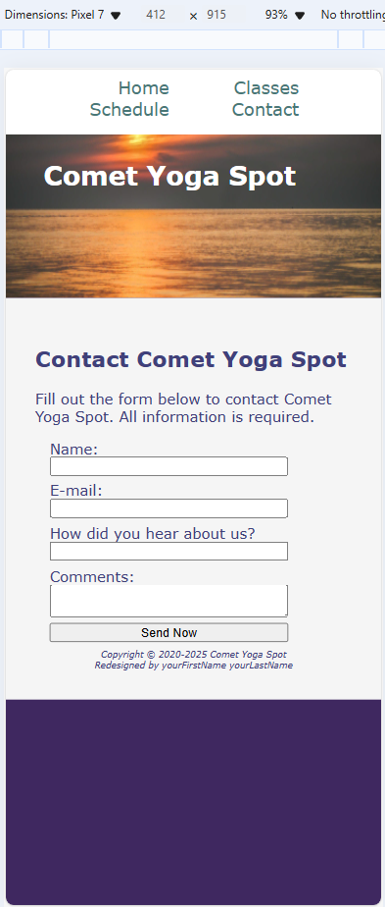
contact.html

